Slide 1
The CPS & charging decisions: A study of disparities by ethnicity, gender & age of suspect
School of Law
Dr Jose Pina-Sánchez and Dr Sam Lewis

Slide 2
An Introduction to the Research
We examined all charging decisions made between April 2019 and March 2020 that led to a charge, caution or NFA.
This amounted to 84,708 cases.
The project began in October 2020. A first draft of the findings report was submitted in March 2021. The report was finalised in December 2021.
A note on terminology

Slide 3
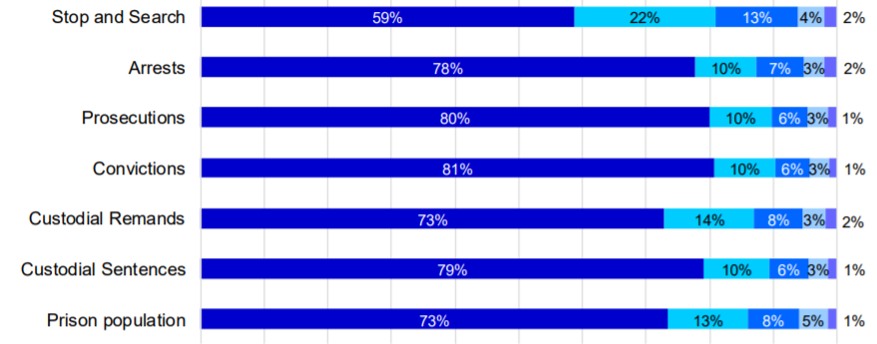

Background and Context
Adults at different stages of the CJS by ethnic group, 2018
Notes:
ONS population estimates for 2019 (https://www.ons.gov.uk/peoplepopulationandcommunity/populationandmigration/populationestimates/articles/populationestimatesbyethnicgroupandreligionenglandandwales/2019)
The disproportionality can be greater for young people: over 50% of the youth prison population is from a BAME background. See p. 3 of the S95 statistics: https://assets.publishing.service.gov.uk/government/uploads/system/uploads/attachment_data/file/849200/statistics-on-race-and-the-cjs-2018.pdf. See also the latest Youth Justice Statistics: https://www.gov.uk/government/statistics/announcements/youth-justice-statistics-2020-to-2021
The issues are greater in some parts of the country: 9/10 children on remand in London from a BAME background. See: https://www.theguardian.com/society/2020/dec/21/nine-out-of-10-children-on-remand-in-london-come-from-bame-background

Slide 4
Background and Context
A series of equality and diversity impact assessments published between 2005 and 2009 reported no significant differences in the proportion of males charged by ethnicity;
Uhrig stated that ‘CPS charging decisions were often proportionate or slightly favoured BAME groups relative to the White group’ (2016: 14);
Lammy concluded that ‘CPS decision-makers are making broadly proportionate decisions across ethnic groups’ (2017: 20).

Slide 5
Research Questions
Do charge rates vary by ethnicity, age and gender of subject?
Do ethnic disparities in charge rates vary by CPS Area?
Do ethnic disparities in charge rates vary by offence type?
To what extent to ethnic disparities in charge rates interact with age and gender?

Slide 6
Methods
Stage 1: Examined the raw (or ‘unadjusted’) data for disparities
Stage 2: We examined the data for disparities after controlling for key suspect (ethnicity, gender and age) and case (offence type and number of suspects) characteristics.
NB: Methodological limitations
Notes:
It is important to note that previous research (Chen and Lewis, Uhrig that informed Lammy) was also based on unadjusted data. If the picture that we present at Stage 1 looks different to that presented previously, one conclusion might be that the picture has changed.

Slide 7
Findings: Age and Gender Disparities
Gender
A higher proportion of cases involving male suspects (71.4%), compared to female suspects (66.1%), resulted in charges
However, after ‘controlling’ for key suspect (ethnicity, gender and age) and case (offence type and number of suspects) characteristics, variations in charge rates by gender were not statistically significant
Age
After controlling for suspect and case characteristics, the odds of charge for suspects aged 18-24 and 60-69 were 28% and 44% higher than for those aged 25-59

Slide 8
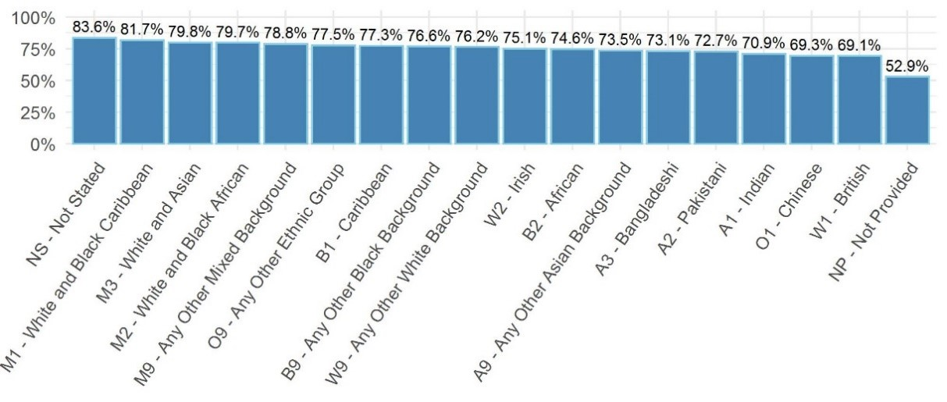
Findings: Ethnic Disparities
Unadjusted charge rates

Slide 9
Findings: Ethnic Disparities
After controlling for subject and case characteristics, ethnic disparities remain significant across all ethnic groups
Ethnicity | Odds ratio
Indian | 1.54
Pakistani | 1.44
Bangladeshi | 1.55
Chinese | 1.57
Other Asian | 1.63
Black Caribbean | 1.77
Black African | 1.57
Other Black | 1.71
Ethnicity | Odds ratio
White & Black Caribbean | 2.32
White & Black African | 2.32
White & Asian | 2.67
Other mixed background | 2.27
White Irish | 1.92
Other White | 1.79
Other ethnicity | 2.10
Ethnicity not provided | 0.55
Ethnicity not stated | 2.51

Slide 10
Findings: Ethnic Disparities (by offence type)
After controlling for subject and case characteristics, odds of charge for BAME suspects where 63% higher than for White suspects,
However, this disparity vary significantly by offence type (* denotes statistically significant ethnic disparities)
Offence type | Odds ratio
Burglary | 2.30*
Against the person | 2.25*
Homicide | 2.12*
Drugs | 1.85*
Criminal damage | 1.80*
Undefined | 1.54*
Offence type | Odds ratio
Fraud & forgery | 1.30*
Theft & handling | 1.27*
Other | 1.20
Motoring | 1.16
Public order | 1.15
Sex | 1.11
Robbery | 1.11

Slide 11
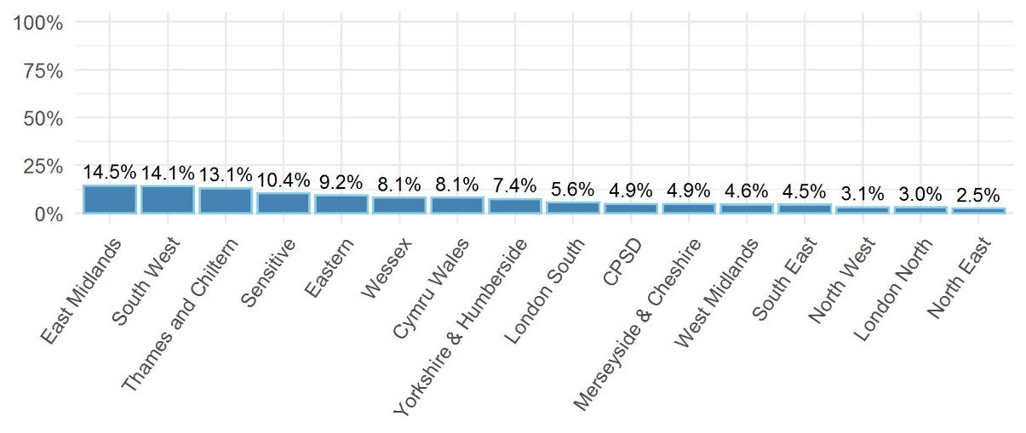
Findings: Ethnic Disparities (by CPS area)
Differences in unadjusted charge rates for White and BAME suspects across CPS areas

Slide 12
Findings: Ethnic Disparities (by CPS area)
After controlling for subject and case characteristics, ethnic disparities remain significant across most CPS areas, but their prevalence is highly variable
CPS area | Odds ratio
South West | 2.91*
Thames & Chiltern | 2.77*
East Midlands | 2.67*
Wessex | 2.48*
CPSD | 2.39*
Eastern | 2.20*
Merseyside & Cheshire | 2.00*
Cymru / Wales | 1.90*
CPS area | Odds ratio
North West | 1.59*
South East | 1.57*
North East | 1.55*
London South | 1.46*
Yorkshire & Humberside | 1.44*
West Midlands | 1.43*
Sensitive | 1.37
London North | 1.23*

Slide 13
Limitations: Unobserved Factors & Missing Data
Unobserved factors
Case characteristics affecting charging decisions that were left uncontrolled
E.g. previous convictions, domestic abuse, murder/manslaughter
If some of the above are more present in BAME groups, then the reported ethnic disparities are overestimated, and vice versa
Missing data affecting the measure of ethnicity
16.6% of the suspects’ ethnicity were recorded as ‘not stated’ (suspects declining to state their ethnicity), 19.8% as ‘not provided’ (ethnicity was not collected by the police)
The charge rate for the former is 83.6%, 52.9% for the latter, the sample average is 70.3%
If a higher proportion of those electing not to provide details of their ethnicity are from BAME groups, then the reported ethnic disparities are underestimated

Slide 14
Limitations: Upstream Disparities?
The work of the CPS occurs downstream of police practice; could this account for some of the disparities reported?
Indirect discrimination?
Overpolicing in areas of higher ethnic minority population leads to BAME longer criminal histories
Racially constructed cases? I.e. two identical cases defined differently. E.g. a ‘borderline’ offence against the person presented as a sex offence, and this happening more commonly for BAME than for White suspects
Systemic disproportionality in the criminal justice system?
The fact BAME suspects are over-represented in our sample does not affect the reported ethnic disparities in the probability of being charged
Put differently, it does not matter whether the sample is composed of 20% or 80% BAME suspects

Slide 15
Going forward …
Further analysis is planned with a larger sample size, to determine variations in charge rate by area, ethnicity and offence type;
Qualitative research to interrogate local police and CPS case files coupled with interviews / focus groups with local practitioners may be considered;
Work is planned to estimate the required 'strength' of the factors left out of our models that would be needed to render the estimated ethnic disparities in charge rates non-significant (sensitivity analysis);
Brief notes reviewing the progress of ethnic disparities in charge across time should be published on an annual basis
Notes:
Qualitative research can reveal additional variables to be included in the statistical models
Sensitivity analysis – simple answer … stronger than is plausible

Slide 16
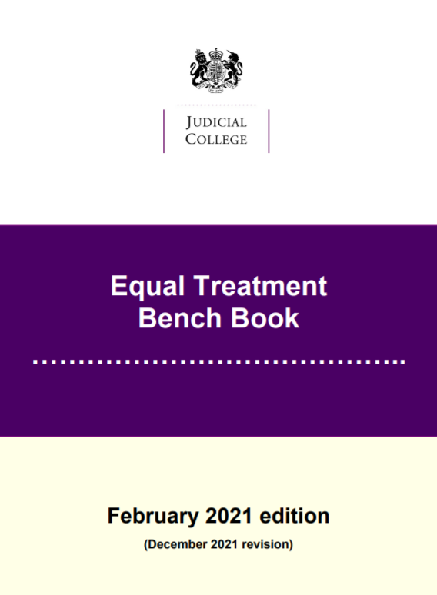
Going forward ...
Work to address the gaps in ethnicity data and understand why some suspects elect not to provide such information is recommended.
The provision of information and guidelines for CPS prosecutors to support a 'race conscious' approach, e.g.

